Slide 1
SEGUIN I.S.D. Financial Integrity Rating System of Texas (FIRST REPORT)
2020-2021 Ratings based on school year 2019-20 data.
Scoring system is based on a series of indicators (questions)
A – Superior Achievement Score 90 - 100
B – Above Standard Achievement Score 80 - 89
C – Standard Achievement Score 60 - 79
F – Substandard Achievement Score below 60

Slide 2
SEGUIN I.S.D. Financial Integrity Rating System of Texas (FIRST REPORT)
THE INDICATORS

Slide 3
SEGUIN I.S.D. Financial Integrity Rating System of Texas (FIRST REPORT)
INDICATOR 1:
Was the annual financial report filed within 30 days after the TEA set deadline of November 27th?
RESPONSE:
Report was received by TEA on AFR Due Date Waiver Granted
SCORE:
Passed

Slide 4
SEGUIN I.S.D. Financial Integrity Rating System of Texas (FIRST REPORT)
INDICATOR 2:
Was there an unmodified opinion in the annual financial report on the financial statements as a whole?
RESPONSE:
For 2019-20, Seguin ISD received an unmodified, or clean, opinion.
SCORE:
Passed

Slide 5
SEGUIN I.S.D. Financial Integrity Rating System of Texas (FIRST REPORT)
INDICATOR 3:
Was the district in compliance with the payment terms of all debt agreements at fiscal year end?
RESPONSE:
Debt payments were made within the requirements of bond covenants.
SCORE:
Passed

Slide 6
SEGUIN I.S.D. Financial Integrity Rating System of Texas (FIRST REPORT)
INDICATOR 4:
Did the district make timely payments to Teachers Retirement System, Texas Workforce Commission, Internal Revenue Service, and other government agencies?
RESPONSE:
All reports and payments were submitted timely to governmental entities.
SCORE:
Passed

Slide 7
SEGUIN I.S.D. Financial Integrity Rating System of Texas (FIRST REPORT)
INDICATOR 5:
This indicator is not being scored.
RESPONSE:
n/a
SCORE:
n/a

Slide 8
SEGUIN I.S.D. Financial Integrity Rating System of Texas (FIRST REPORT)
INDICATOR 6:
Was the average change in fund balances over 3 years less than a 25% decrease or did the current year’s unassigned and assigned fund balances exceed 75 days of operational expenditures?
RESPONSE:
Both criteria met in the fiscal year.
SCORE:
Passed

Slide 9
SEGUIN I.S.D. Financial Integrity Rating System of Texas (FIRST REPORT)
INDICATOR 7:
Was the number of days of cash on hand and current investments in the general fund for the school district sufficient to cover operating expenditures?
RESPONSE:
Seguin ISD had sufficient cash and investments in the General Fund.
SCORE: (maximum possible score: 10 points)
10 Points

Slide 10
SEGUIN I.S.D. Financial Integrity Rating System of Texas (FIRST REPORT)
INDICATOR 8:
Was the measure of current assets to current liabilities ratio for the school district sufficient to cover short-term debt?
RESPONSE:
Current Assets $80,886,257
Current Liabilities $22,541,372
Ratio: 3.5883
Current assets were sufficient to cover current liabilities.
SCORE: (maximum possible score: 10 points)
10 Points

Slide 11
SEGUIN I.S.D. Financial Integrity Rating System of Texas (FIRST REPORT)
INDICATOR 9:
Did the school district’s general fund revenues equal or exceed expenditures?
RESPONSE:
Total Revenue $65,445,080
Total Expenditures $65,214,364
Net Result of Operations $ 230,716
Revenues were sufficient to cover expenditures.
SCORE: (maximum possible score: 10 points)
10 Points

Slide 12
SEGUIN I.S.D. Financial Integrity Rating System of Texas (FIRST REPORT)
INDICATOR 10:
Did the district average less than a 10% variance when comparing budgeted revenues to actual revenues for the last 3 years?
RESPONSE:
Seguin ISD had sufficient cash and investments in the General Fund.
SCORE: (maximum possible score: 10 points)
10 Points

Slide 13
SEGUIN I.S.D. Financial Integrity Rating System of Texas (FIRST REPORT)
INDICATOR 11:
Was the ratio of long-term liabilities to total assets for the school district sufficient to support long-term solvency?
RESPONSE:
Long Term Liabilities $167,344,181
Total Assets $225,720,033
Ratio: 0.7414
Assets were sufficient to cover liabilities.
SCORE: (maximum possible score: 10 points)
6 Points (points reduction due to Net Pension Liability)

Slide 14
SEGUIN I.S.D. Financial Integrity Rating System of Texas (FIRST REPORT)
INDICATOR 12:
Was the debt per $100 of assessed property value ration sufficient to support future debt repayments?
RESPONSE:
Resources were sufficient to meet required debt service.
SCORE: (maximum possible score: 10 points)
8 Points (additional bond debt)

Slide 15
SEGUIN I.S.D. Financial Integrity Rating System of Texas (FIRST REPORT)
INDICATOR 13:
Was the district’s administrative cost ratio less than the threshold ratio?
RESPONSE:
Acceptable Administrative Cost Ratio 10.00 <= 12.50%
Seguin ISD Administrative Cost Ratio 10.27%
SCORE: (maximum possible score: 10 points)
8 Points

Slide 16
SEGUIN I.S.D. Financial Integrity Rating System of Texas (FIRST REPORT)
INDICATOR 14:
Did the school district not have a 15% decline in the students to staff ratio over 3 years?
RESPONSE:
Seguin ISD did not have a decline in its ratio of students to staff that was outside the acceptable range.
SCORE: (maximum possible score: 10 points)
10 Points

Slide 17
SEGUIN I.S.D. Financial Integrity Rating System of Texas (FIRST REPORT)
INDICATOR 15:
Was the district’s ADA within the allotted range of the district’s biennial pupil projection submitted to TEA?
RESPONSE:
Seguin ISD ADA was within the allotted range.
SCORE: (maximum possible score: 5 points)
5 Points

Slide 18
SEGUIN I.S.D. Financial Integrity Rating System of Texas (FIRST REPORT)
INDICATOR 16:
Did the comparison of PEIMS data to like information in the annual financial report result in a variance of less than 3% of expenditures per function?
RESPONSE:
Sum of Differences $1,503
Expenditures $65,215,777
The PEIMS financial data submitted by Seguin ISD to TEA had an insignificant variance in comparison to the data published in the annual financial report. The variance is due to system rounding.
SCORE:
Passed

Slide 19
SEGUIN I.S.D. Financial Integrity Rating System of Texas (FIRST REPORT)
INDICATOR 17:
Did the external auditor indicate the annual financial statement was free of any instance(s) of material weaknesses in internal controls over financial reporting and compliance for local, state, or federal funds?
RESPONSE:
External auditor indicated strong internal controls.
SCORE:
Passed

Slide 20
SEGUIN I.S.D. Financial Integrity Rating System of Texas (FIRST REPORT)
INDICATOR 18:
Did the external auditor indicate the annual financial report was free of any instance(s) of material noncompliance for grants, contracts, and laws related to local, state of federal funds?
RESPONSE:
The Seguin ISD annual financial report indicated no material noncompliance.
SCORE: (maximum possible score: 10 points)
10 Points

Slide 21
SEGUIN I.S.D. Financial Integrity Rating System of Texas (FIRST REPORT)
INDICATOR 19:
Did the district post the required financial information on its website in accordance with Government Code, Local Government Code, Texas Education Code, Texas Administrative Code and other statues, laws, and rules were in effect at the district's fiscal year end?
RESPONSE:
Seguin ISD met all requirements.
SCORE: (maximum possible score: 5 points)
5 Points

Slide 22
SEGUIN I.S.D. Financial Integrity Rating System of Texas (FIRST REPORT)
INDICATOR 20:
Did the school board members discuss the district’s property values at the board meeting within 120 days before the district adopted it’s budget?
RESPONSE:
Seguin ISD met requirements.
SCORE:
Passed

Slide 23
SEGUIN I.S.D. Financial Integrity Rating System of Texas (FIRST REPORT)
Seguin ISD FIRST Results for 2020
A – Superior Achievement
92 Points (maximum possible score: 100 points)

Slide 24
SEGUIN I.S.D. Financial Integrity Rating System of Texas (FIRST REPORT)
PRIOR YEAR COMPARISON

Slide 25
SEGUIN I.S.D. Financial Integrity Rating System of Texas (FIRST REPORT)
INDICATOR 1 2 2.A 2.B 3 4 5 6 7 8 9 10 11 12 13 14 15 16 17 18 19 20
2020
PASS
PASS
n/a
n/a
PASS
PASS
n/a
PASS
10
10
10
10
6
8
8
10
5
PASS
PASS
10
5
PASS
2019
PASS
PASS
PASS
PASS
PASS
n/a
10
10
6
10
10
10
10
10
10
10
n/a
n/a
n/a
n/a
n/a
n/a
2018 PASS PASS PASS PASS PASS n/a 10 10 6 10 10 10 10 10 10 10 n/a n/a n/a n/a n/a n/a
2017 PASS PASS PASS PASS PASS PASS 10 10 6 10 10 10 10 10 10 10 n/a n/a n/a n/a n/a n/a
TOTAL SCORE
92
96
96
96

Slide 26
SEGUIN I.S.D. Financial Integrity Rating System of Texas (FIRST REPORT)
REQUIRED DISCLOSURE:
Reimbursements Received by the Superintendent and Board Members for Fiscal Year 2020

Slide 27
SEGUIN I.S.D. Financial Integrity Rating System of Texas (FIRST REPORT)
Reimbursement Received by the Superintendent & Board Members for Fiscal Year 2020
For the 12 Month Period
Ended June 30, 2020
Description of Reimbursements | Superintendent | Board Members
 | Dr. Matthew Gutierrez | Carl Jenkins | Alejandro Guerra | Cindy Thomas-Jimenez | Linda Duncan | Denise Crettenden | Benito Amador | Glenda Moreno
Meals | $ 660.50 | $ 139.00 | $ 39.00 | $ 137.47 | $ 139.00 | $ 78.00 | $ - | $ 139.00
Lodging | $ 1,608.45 | $ 684.30 | $ 684.30 | $ 684.30 | $ 684.30 | $ 684.30 | $ - | $ 684.30
Transportation | $ 1,178.31 | $ - | $ 300.33 | $ 264.60 | $ 132.30 | $ 327.38 | $ - | $ 310.06
Registration | $ 770.00 | $ 425.00 | $ 425.00 | $ 695.00 | $ 620.00 | $ 620.00 | $ 320.00 | $ 625.00
Other | $ - | $ - | $ - | $ - | $ - | $ - | $ - | $ -
Total | $4,217.26 | $1,248.30 | $1,448.63 | $1,781.37 | $1,575.60 | $1,709.68 | $320.00 | $1,758.36

Slide 28
SEGUIN I.S.D. Financial Integrity Rating System of Texas (FIRST REPORT)
Outside Compensation and/or Fees Received by the Superintendent for Professional Consulting and/or Other Personal Services in Fiscal Year 2020
For the Twelve-Month Period
Ended June 30, 2020 |  |  | $0.00
Note-Compensation does not include business revenues from the superintendent's livestock or agricultural livestock or agricultural based activities on a ranch or farm. Revenues generated from a family business that have no relationship to school district business are not disclosed.
Gifts Received by Executive Officers and Board Members (and First Degree Relatives, if any) in Fiscal Year 2020
For the Twelve-Month Period
Ended June 30, 2020 |  |  | None
Note – An executive officer is defined as the superintendent, unless the board of trustees or the district administration names additional staff under this classification. (Any gifts received by their immediate family as described in Government Code, Chapter 573, Subchapter B, Relationships by Consanguinity or by Affinity are reported under the applicable school official.)
Business Transactions Between School District and Board Members for Fiscal Year 2020
For the Twelve-Month Period
Ended June 30, 2020 |  |  | None
Note - The summary amounts reported under this disclosure do not duplicate the items disclosed in the summary schedule of reimbursements received by board members.
Other Information. None

Slide 29
SEGUIN I.S.D. Financial Integrity Rating System of Texas (FIRST REPORT)
REQUIRED DISCLOSURE:
Local Government Officer Conflicts Disclosure Statement

Slide 30
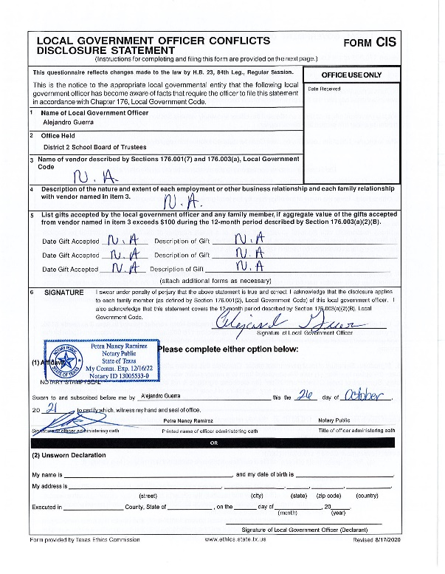
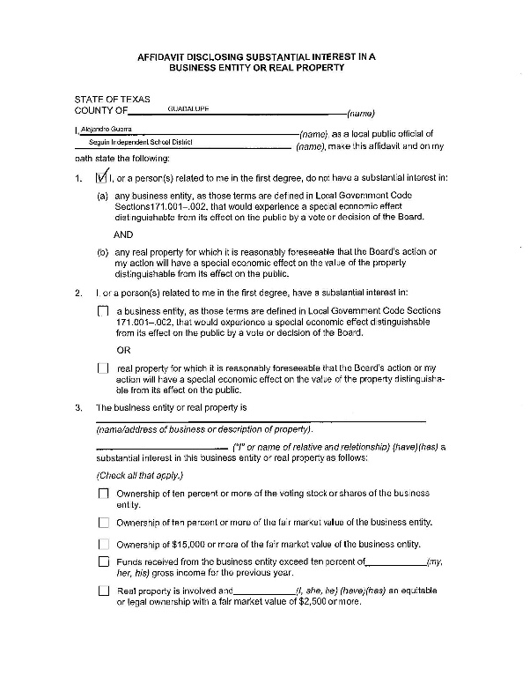
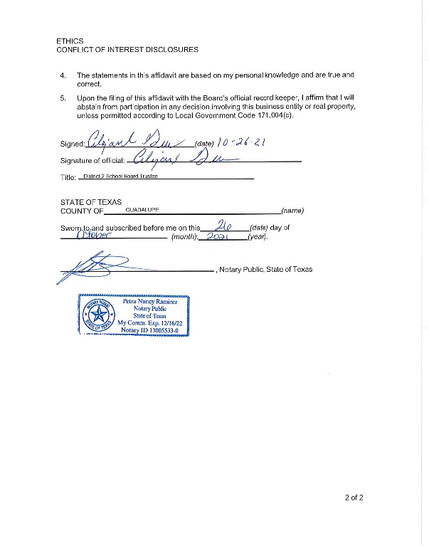
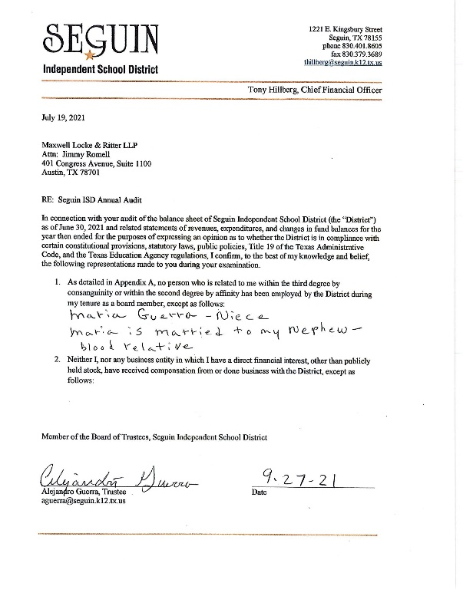
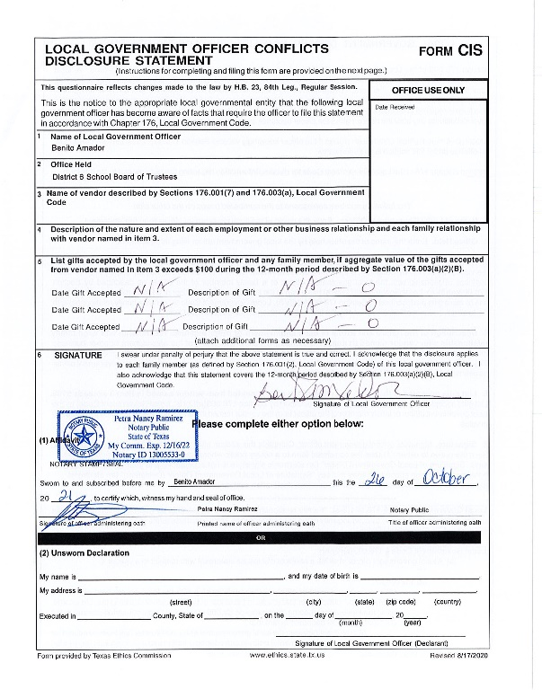
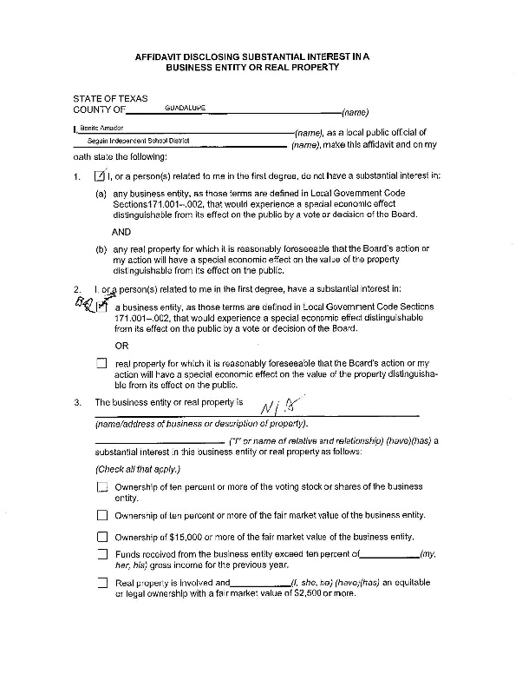
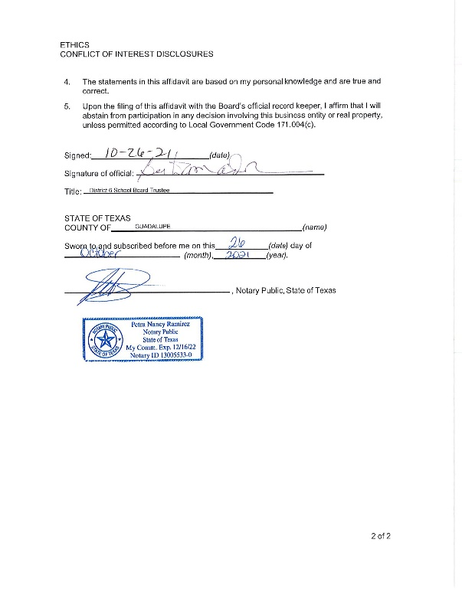
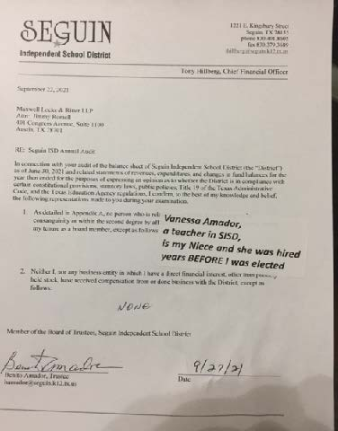

Slide 31
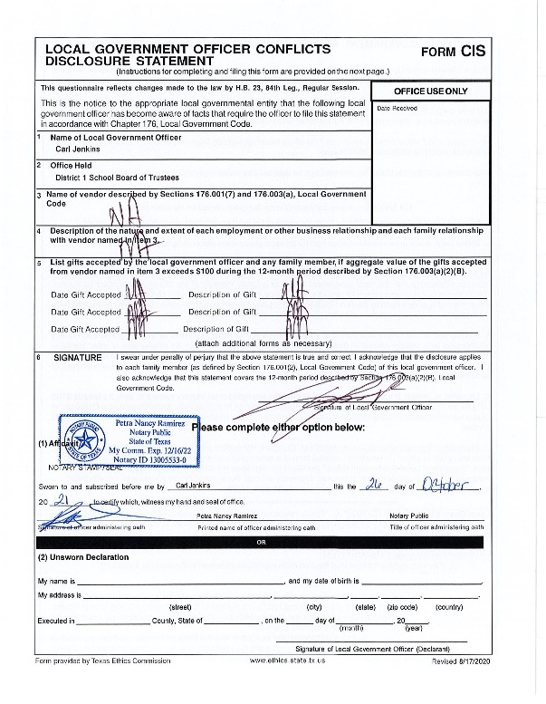
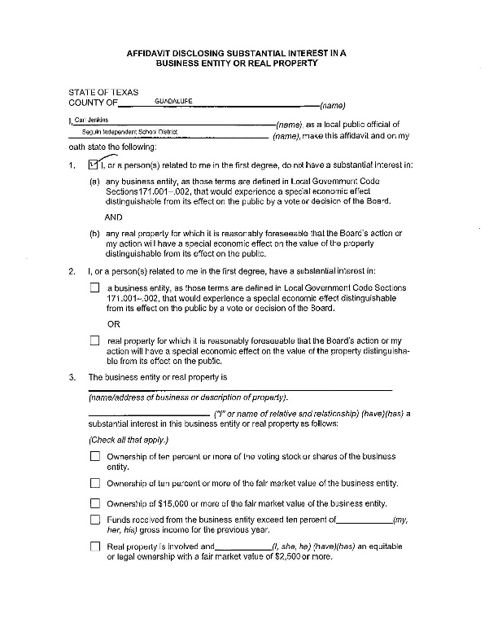
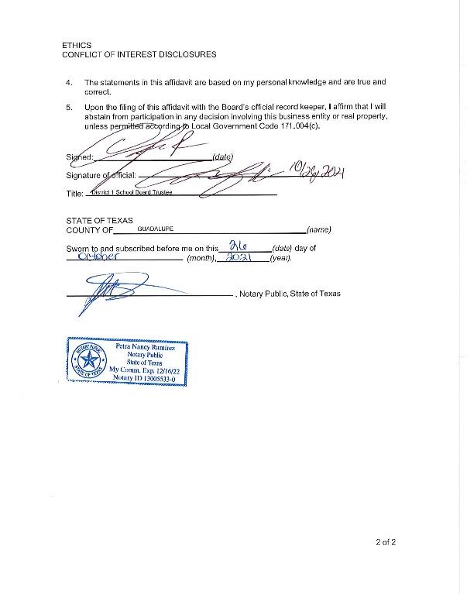
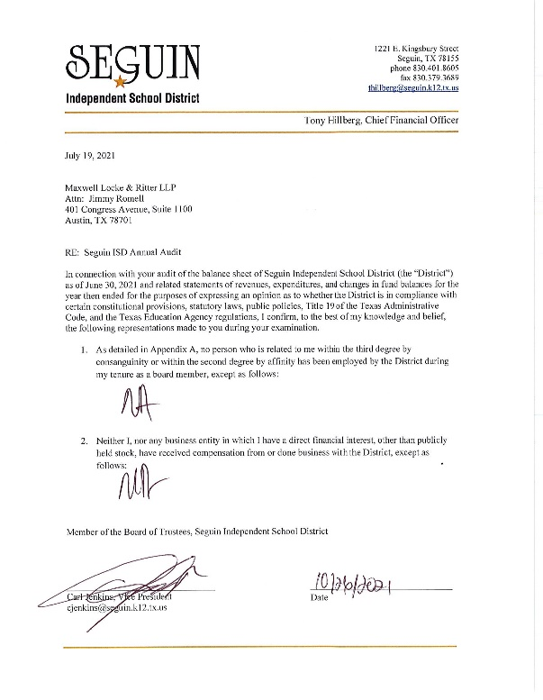
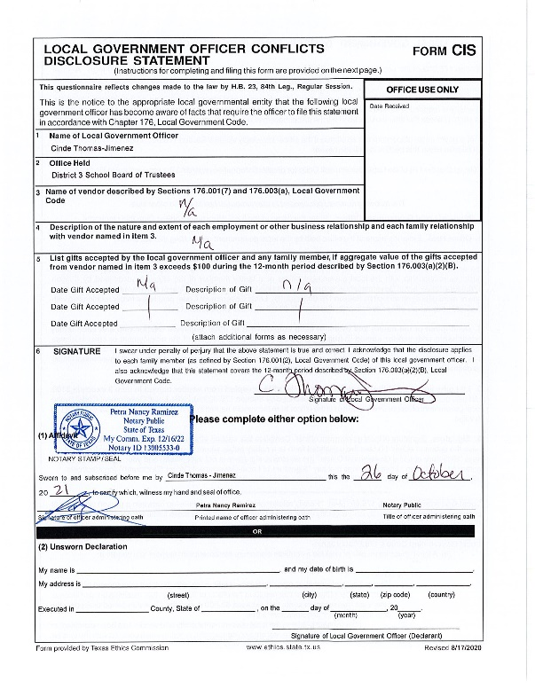
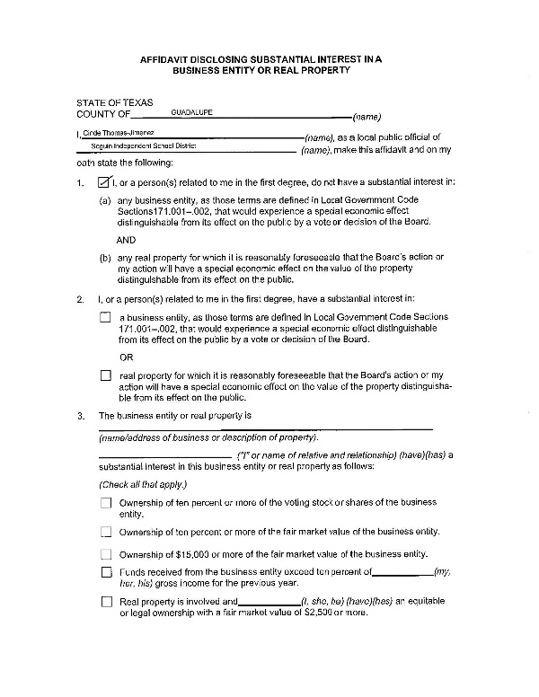
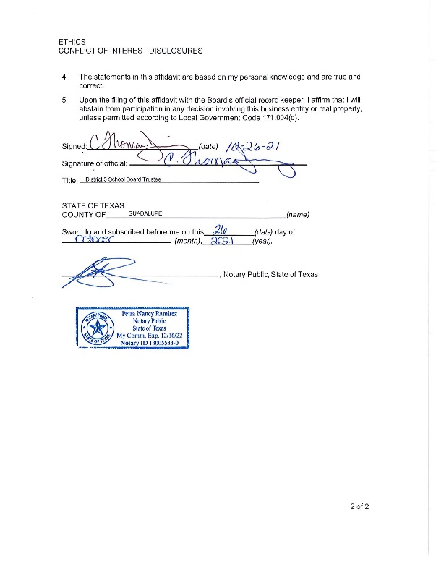
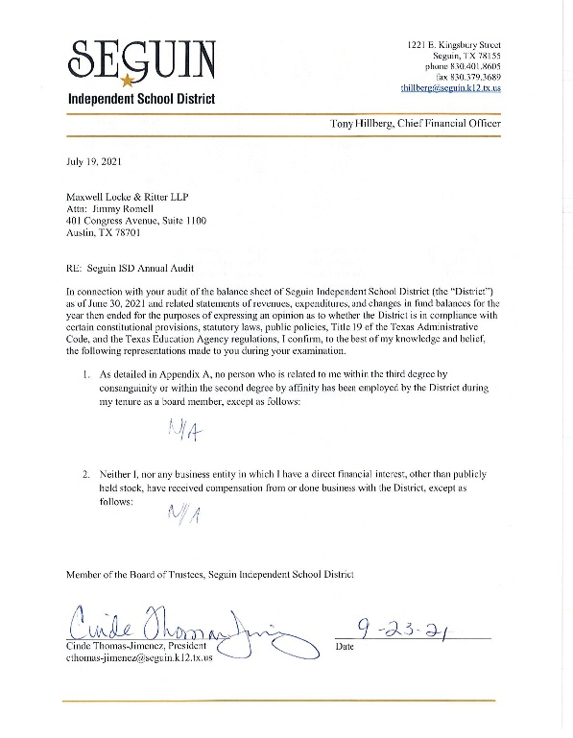

Slide 32
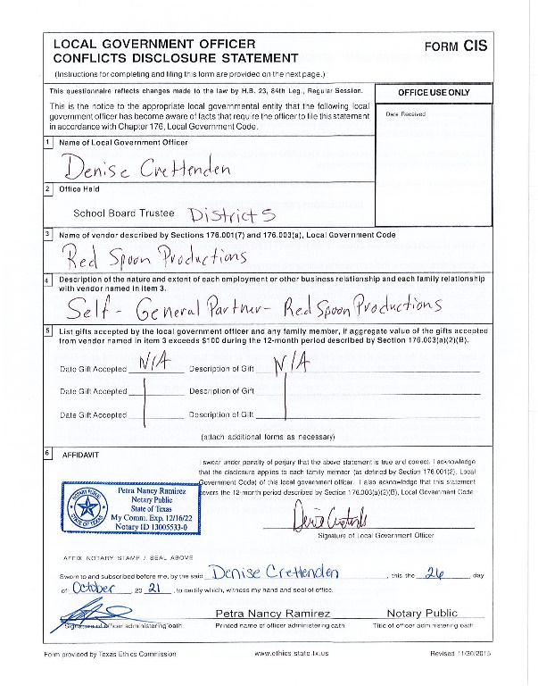
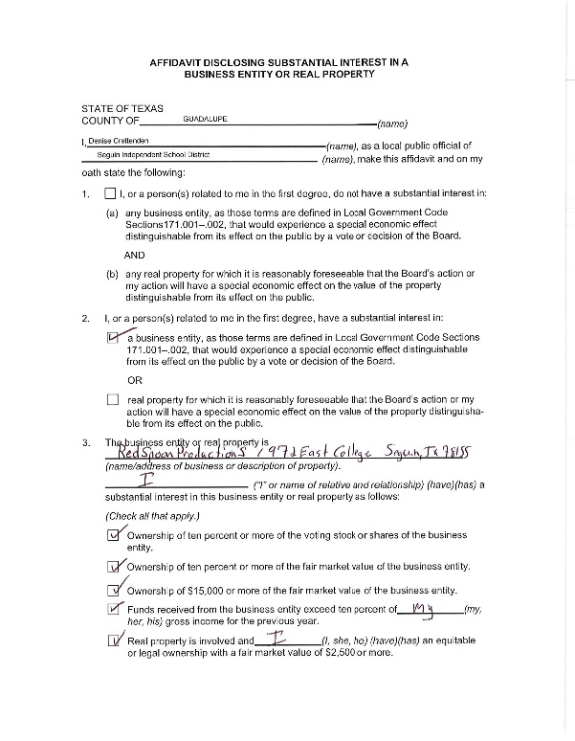
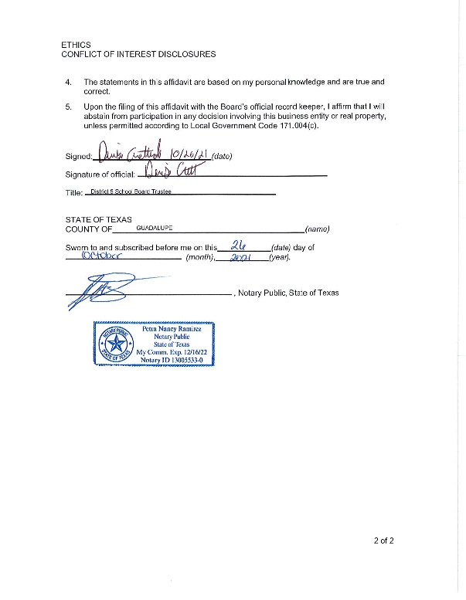
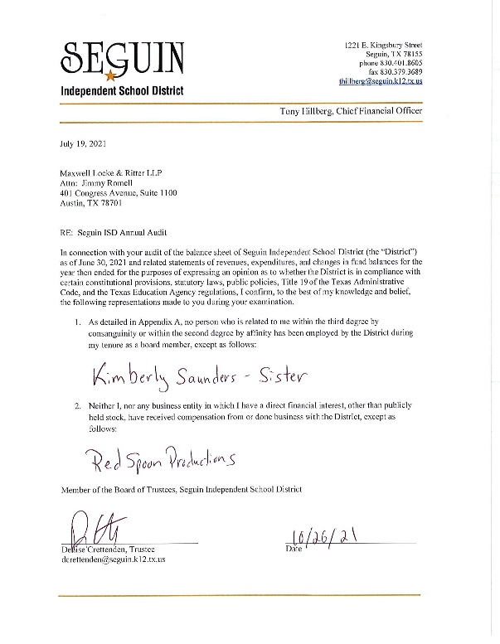
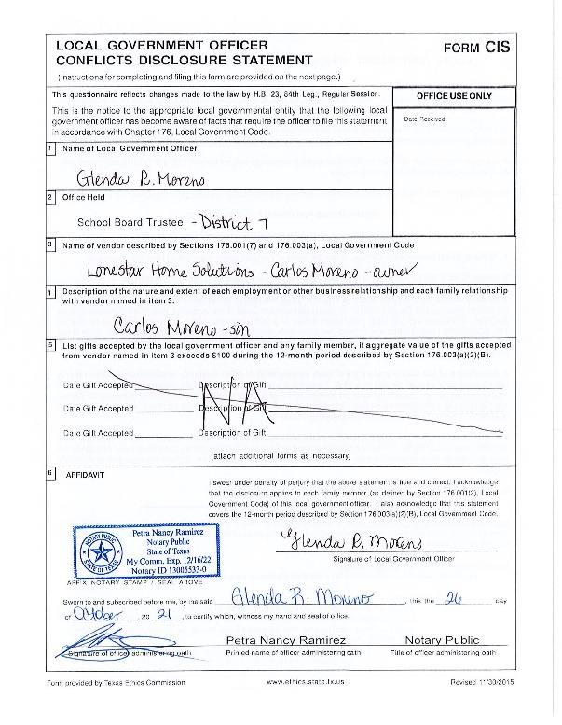
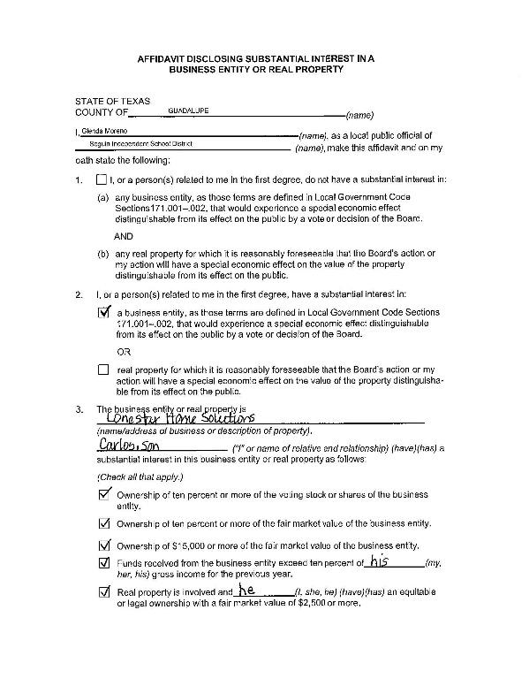
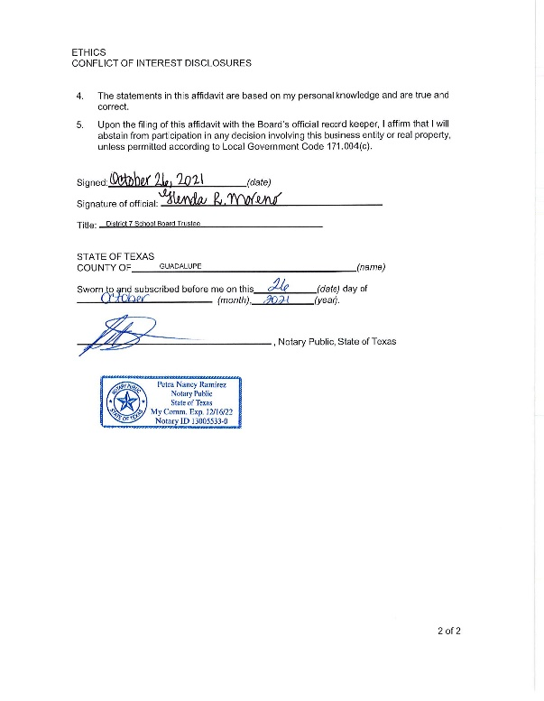
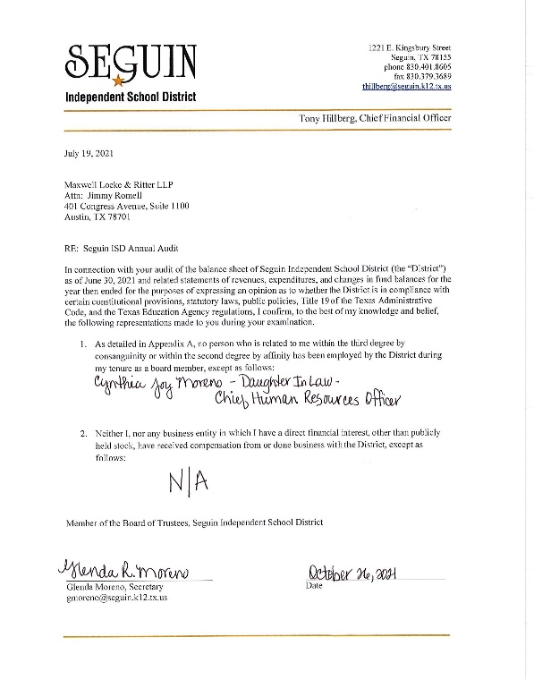

Slide 33
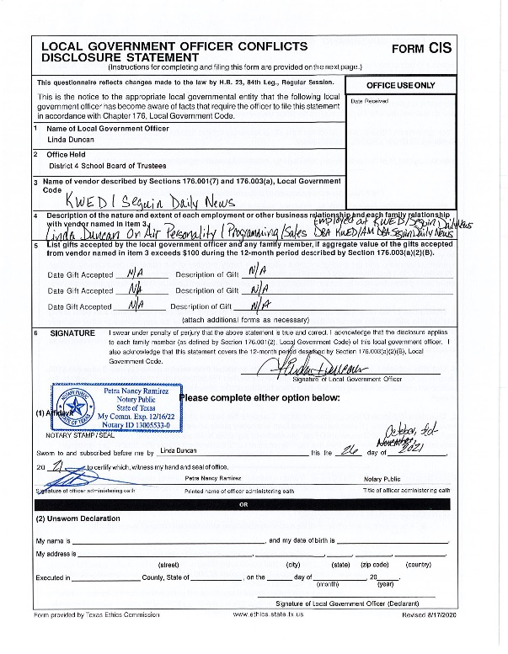
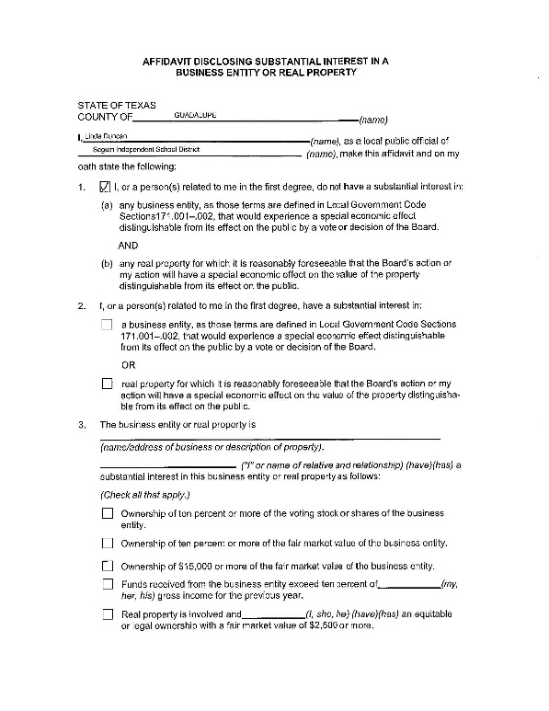
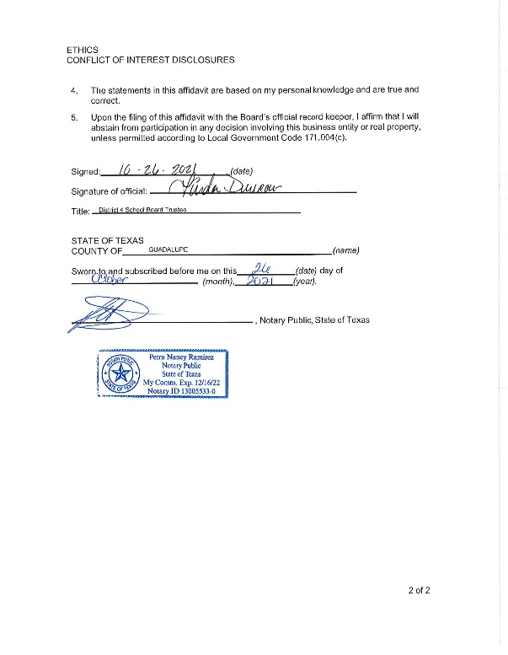
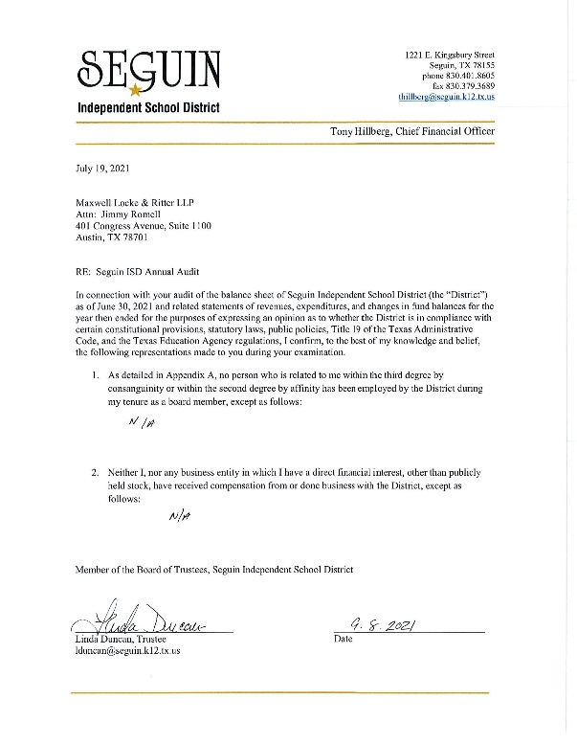

Slide 34
SEGUIN I.S.D. Financial Integrity Rating System of Texas (FIRST REPORT)
REQUIRED DISCLOSURE:
Official 2020-2021 FIRST Report from TEA

Slide 38
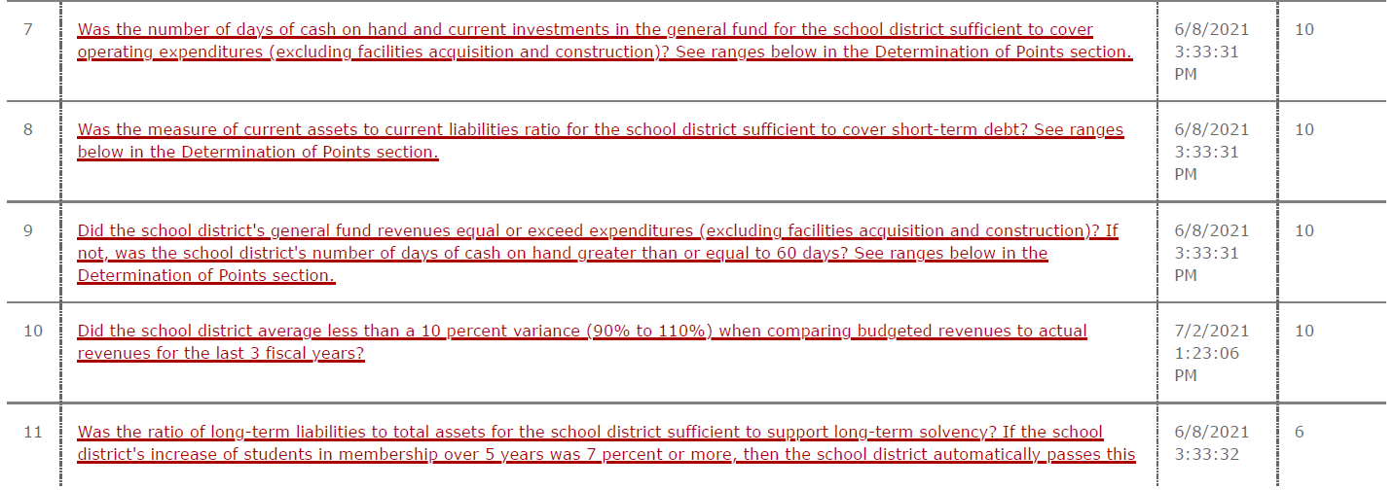

Slide 41
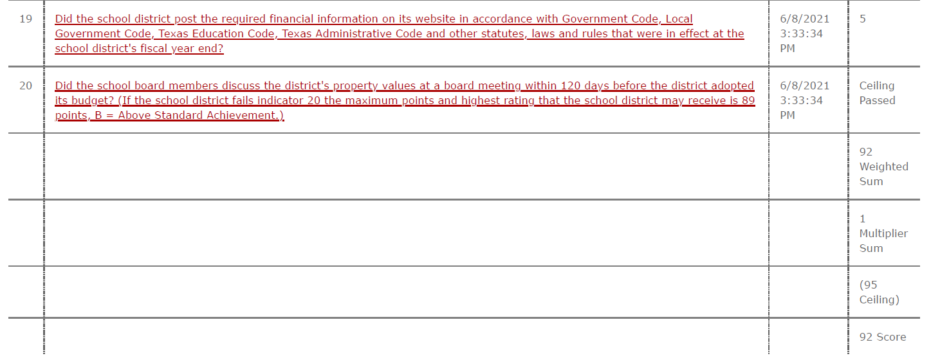

Slide 42
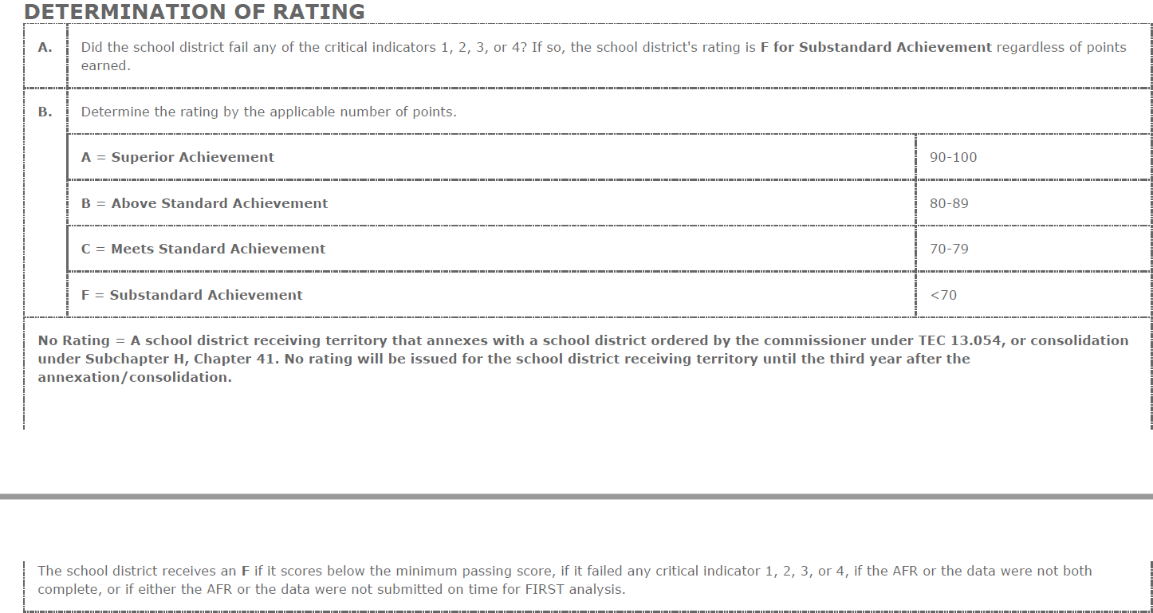

Slide 43
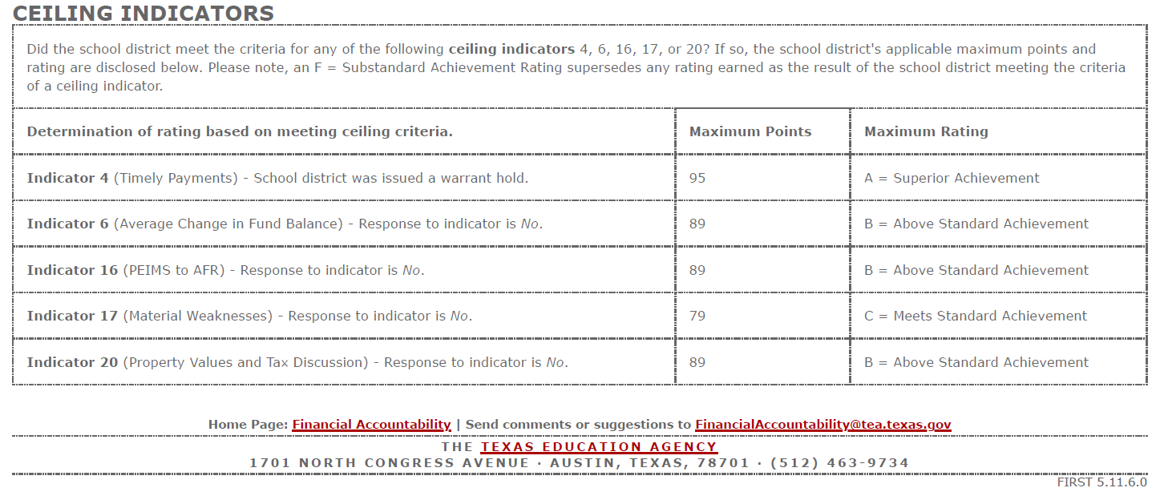

Slide 44
SEGUIN I.S.D. Financial Integrity Rating System of Texas (FIRST REPORT)
REQUIRED DISCLOSURE:
Superintendent’s Employment Contract
https://www.seguin.k12.tx.us/upload/page/0141/2021-2022/Supt.%20Contract%2021.0623.pdf

Slide 45
SEGUIN I.S.D. Financial Integrity Rating System of Texas (FIRST REPORT)
QUESTIONS
Contact Tony Hillberg, Chief Financial Officer
(830) 401-8605
thillberg@seguin.k12.tx.us

